Slide 1
Understanding the
Challenge Scoring Metric
George B. Moody PhysioNet Challenge 2026
How submissions are ranked — and what it means for our model
Arshia Ilaty · SDG
July 13, 2026
Notes:
Welcome, everyone. Today I want to walk through how the George B. Moody PhysioNet Challenge 2026 actually scores and ranks the teams that enter. This matters for us because the metric — not our intuition about accuracy — decides where we land on the leaderboard. My goal is that by the end, everyone understands exactly what we're being graded on and how that shapes the way we build and validate our model.

Slide 2
What we'll cover
AGENDA
1
The prediction task What the challenge asks our model to output
2
Why a custom metric Class imbalance and age act as confounders
3
The seven scores One primary ranking metric, six diagnostics
4
The Reward metric Prevalence-weighted payoff — the metric that ranks us
5
Age-aware AUROC Conditioned and age-weighted variants
6
The dataset behind the metric The cohort the model actually sees — and the confounders it must beat
7
What it means for us How we tune and validate against the metric
PhysioNet Challenge 2026 · Scoring Metrics
Notes:
Here's the plan. First I'll frame the prediction task — what the challenge actually asks our model to output. Then I'll explain why the organizers built a custom metric instead of using plain accuracy. We'll look at the seven scores the evaluation produces, then spend most of our time on the one that matters — the Reward — because that's the metric that ranks us. After that, the age-aware AUROCs, and finally what all of this means for how we should tune and validate. Feel free to hold questions until the relevant section, but jump in if something isn't clear.

Slide 3
The prediction task
Notes:
Let's start with the task itself, because the metric only makes sense once you know what we're predicting.

Slide 4
What the model must predict
THE TASK
From overnight sleep / physiological recordings, predict whether a patient has cognitive impairment.
OUTPUT 1 — BINARY
Cognitive_Impairment
0 or 1 per patient. Scored by the Reward metric.
OUTPUT 2 — PROBABILITY
Cognitive_Impairment_Probability
Continuous score in [0,1]. Scored by the AUROC / AUPRC metrics.
Evaluated per patient, keyed by SiteID + BDSPPatientID. Each patient also carries an Age, which the metric uses to set expectations — see the next section.
PhysioNet Challenge 2026 · Scoring Metrics
Notes:
The task is a per-patient prediction: from an overnight sleep or physiological recording, decide whether that patient has cognitive impairment. Our model produces two things for each patient. First, a binary 0-or-1 call — that's what the Reward metric scores. Second, a continuous probability between 0 and 1 — that's what the AUROC and AUPRC metrics use. Both matter, and they're scored differently, so we can't just optimize one and forget the other. One more detail that becomes important in a minute: every patient carries an age, and the metric uses that age to set its expectations.

Slide 5
Why a custom metric?
Notes:
So why not just use accuracy? There are two specific problems that a naive metric would get wrong.

Slide 6
Two problems plain accuracy can't handle
MOTIVATION
1 · Class imbalance
2 · Age confounding
Impairment is the rare class.
A model that predicts “nobody is impaired” can score high accuracy while being clinically useless.
The metric must reward finding rare positives and give no free credit for trivial guessing.
Risk rises steeply with age.
A model could look accurate just by learning “older = higher risk” — not real physiology.
The metric must compare patients of similar age, so age alone can't inflate the score.
PhysioNet Challenge 2026 · Scoring Metrics
Notes:
Two problems. First, class imbalance: cognitive impairment is the rare class. A lazy model that simply predicts 'nobody is impaired' could post a high accuracy while being clinically worthless. So the metric has to reward actually finding the rare positives and give no free credit for trivial guessing. Second, age confounding: the risk of impairment rises steeply with age. A model could look accurate just by learning 'older equals higher risk' — which is real epidemiology but not real physiological signal from the recording. So the metric has to compare patients of similar age, so age alone can't inflate the score. Keep these two problems in mind — every design choice in the metric is aimed at one of them.

Slide 7
Seven scores — one decides the ranking
OVERVIEW
Metric | Uses | Role
Reward | Binary prediction | PRIMARY — ranks all teams
Age-conditioned AUROC | Probability | Diagnostic
Age-weighted AUROC | Probability | Diagnostic
AUROC | Probability | Diagnostic
AUPRC | Probability | Diagnostic
Accuracy | Binary prediction | Diagnostic
F-measure | Binary prediction | Diagnostic
The Reward determines the leaderboard. The other six help us understand why a model scores as it does.
PhysioNet Challenge 2026 · Scoring Metrics
Notes:
When you run the official evaluation code, you get seven numbers. I want to be crystal clear about their roles. Exactly one — the Reward, at the top, highlighted — determines the ranking. That's the leaderboard. The other six — the two age-aware AUROCs, standard AUROC, AUPRC, accuracy, and F-measure — are diagnostics. They don't rank us, but they help us understand why a model scores the way it does. So when we report results internally, the Reward is the headline; the rest are supporting evidence.

Slide 8
The Reward metric
Notes:
Now the main event — the Reward metric. This is the one that ranks us, so it's worth understanding deeply.

Slide 9
The Reward: a prevalence-weighted payoff
PRIMARY METRIC · INTUITION
Every patient earns points. Correct calls on rare outcomes pay the most; each mistake costs −1. The score is the average over patients.
p = age-specific prevalence of impairment (the base rate expected at that patient's age)
Reward = (1/N) · Σ pointsᵢ averaged across all N scored patients
Correctly flagging a rare case is worth much more than one common correct call.
Every error — false alarm or miss — costs the same −1, so over-predicting is not a free win.
Because payoffs scale with 1/p, the metric self-normalizes: skill shows, guessing doesn't.
PhysioNet Challenge 2026 · Scoring Metrics
Notes:
Here's the intuition. Every patient earns points, and we average the points over all patients. The key quantity is p — the age-specific prevalence of impairment, essentially the base rate we'd expect at that patient's age. Three things fall out of the design. One: correctly flagging a rare case is worth far more than one common correct call. Two: every error — whether a false alarm or a miss — costs the same flat minus one, so over-predicting is never a free win. And three: because the payoffs scale with one over p, the whole metric self-normalizes — genuine skill shows up, and guessing washes out. We'll see both of those on the next few slides.

Slide 10
How each prediction scores
PRIMARY METRIC · PAYOFF
 | Predicted + | Predicted −
Actual + | + (1/p − 1) | −1 (miss)
Actual − | −1 (false alarm) | + (1/(1−p) − 1)
Reading it
Hits on the rare (positive) class pay 1/p − 1 — large when p is small.
Correct negatives pay a small amount, 1/(1−p) − 1.
Any error costs a flat −1.
Worked example at p = 0.15: a correct positive = +5.7, a correct negative = +0.18, any error = −1.
PhysioNet Challenge 2026 · Scoring Metrics
Notes:
Here's the exact scoring, laid out as a payoff matrix. If the patient is truly positive and we call positive — a true positive — we earn one-over-p minus one. Because p is small for the rare class, that's a big reward. If the patient is truly negative and we correctly call negative, we earn one-over-one-minus-p minus one, which is a small amount. And any error — a false alarm or a miss — costs a flat minus one. Concretely, at fifteen-percent prevalence: catching a real positive is worth about plus five-point-seven, a correct negative is worth about plus zero-point-one-eight, and any mistake is minus one. That asymmetry is the whole point — it's expensive to miss impairment.

Slide 11
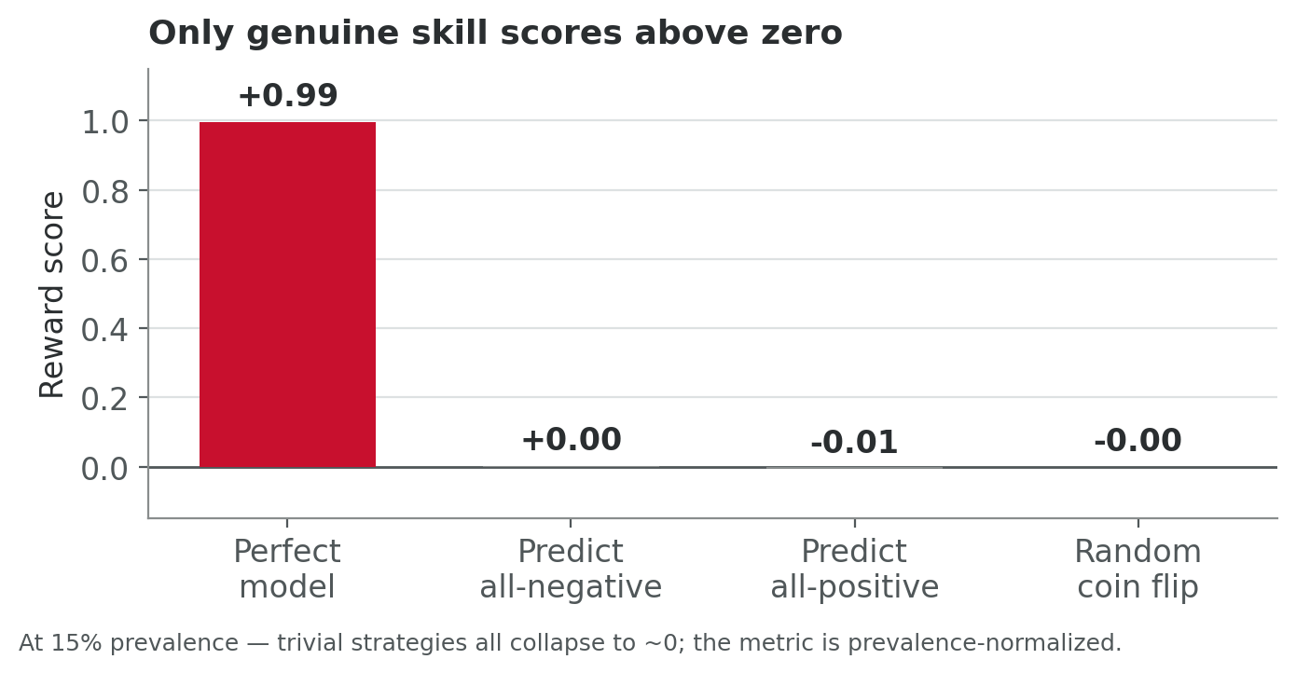
Trivial strategies score zero — by design
PRIMARY METRIC · WHY IT WORKS
Verified in simulation: a perfect model ≈ +1.0; all-negative, all-positive, and random each ≈ 0, at any prevalence.
PhysioNet Challenge 2026 · Scoring Metrics
Notes:
This chart is the payoff of that design. I simulated the four strategies. A perfect model scores about plus one. But look at the other three — predict all-negative, predict all-positive, or flip a coin — they all collapse to essentially zero. And this holds at any prevalence, because of that one-over-p normalization. The takeaway: you cannot game this metric with a trivial strategy. A score meaningfully above zero is evidence of real predictive skill. Zero is the 'no better than guessing' line.

Slide 12
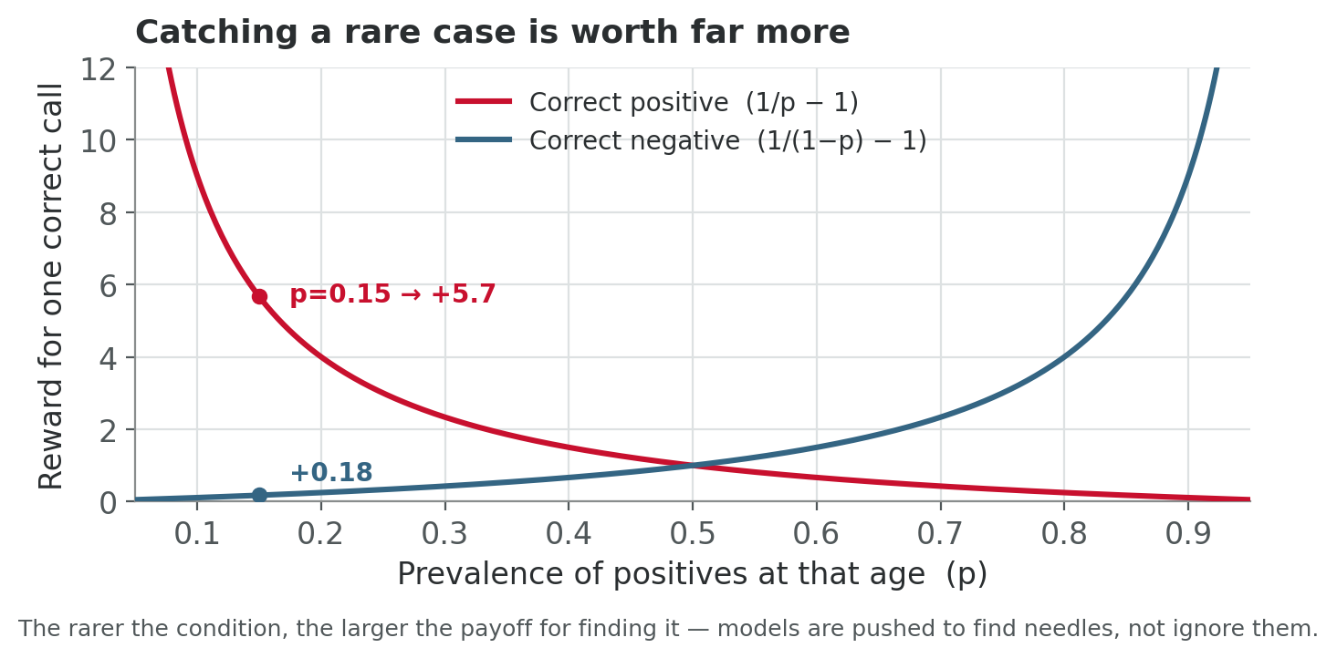
The rarer the case, the bigger the payoff
PRIMARY METRIC · WHY IT WORKS
This is what makes the metric clinically aligned: it pushes the model to catch impairment even when it is uncommon.
PhysioNet Challenge 2026 · Scoring Metrics
Notes:
And this is why the metric is clinically aligned. The red curve is the reward for correctly catching a positive, as a function of how common that condition is at a given age. As prevalence drops — as the condition gets rarer — the payoff shoots up. So the metric actively pushes our model to find the needles, not to ignore them because they're uncommon. The blue curve, correct negatives, stays low and flat until the condition is very common. In short: the rarer the case, the more we're rewarded for catching it — which is exactly the behavior you want from a screening tool.

Slide 13
Age-conditioned AUROC
DIAGNOSTIC METRIC
Standard AUROC asks: given a random positive and a random negative, does the model rank the positive higher?
The age-conditioned version only compares pairs of patients of similar age (within ±2 years).
Why it matters
A model can't win just by learning “older patients are higher-risk.” Within a narrow age band, age is held roughly constant — so the score reflects real physiological signal, not the age–risk correlation.
0.5 = no better than chance · 1.0 = perfect ranking within each age neighborhood.
PhysioNet Challenge 2026 · Scoring Metrics
Notes:
Now the age-aware diagnostics. Standard AUROC asks: if I pick a random positive and a random negative patient, does the model rank the positive as higher-risk? The age-conditioned version adds one restriction — it only compares pairs of patients who are close in age, within about two years. Why does that matter? Because it removes the age shortcut. Within a narrow age band, age is essentially held constant, so a good score reflects real physiological signal, not just the model rediscovering that older patients are higher-risk. As always, zero-point-five is chance and one-point-zero is perfect — but now within each age neighborhood.

Slide 14
Age-weighted AUROC
DIAGNOSTIC METRIC
Computes an AUROC within each age, then averages them — weighting each age by how many patients fall there.
Age-CONDITIONED
One pooled score over all similar-age pairs. Answers: “across the board, does it separate cases within age?”
Age-WEIGHTED
Per-age scores averaged by population. Answers: “how well does it work at a typical patient's age?”
Both remove age as a shortcut; together they show consistency across the age range.
PhysioNet Challenge 2026 · Scoring Metrics
Notes:
The age-weighted AUROC is a close cousin. It computes an AUROC within each age, then averages those per-age scores, weighting each age by how many patients actually fall there. The distinction on the slide: the conditioned version gives one pooled score across all similar-age pairs — 'across the board, does it separate cases within age?' The weighted version averages per-age performance by population — 'how well does it work at a typical patient's age?' Both strip out age as a shortcut. Together, they tell us whether our model is consistently good across the whole age range, or just good at the ages that happen to dominate the dataset.

Slide 15
The familiar four — context, not ranking
DIAGNOSTIC METRICS
AUROC
Probability
Ranking quality overall
Ignores prevalence — optimistic on imbalanced data
AUPRC
Probability
Focus on the positive class
More honest than AUROC when positives are rare
Accuracy
Binary
% of correct calls
Misleading under imbalance — shown for reference
F-measure
Binary
Balance of precision & recall
Threshold-dependent summary of the binary output
PhysioNet Challenge 2026 · Scoring Metrics
Notes:
These four are the metrics everyone already knows, and here they're context, not ranking. Standard AUROC measures overall ranking quality but ignores prevalence, so it's optimistic on imbalanced data. AUPRC focuses on the positive class and is more honest than AUROC when positives are rare — so it's the more informative of the two for us. Accuracy is the percentage of correct calls, but as we discussed it's misleading under imbalance — we show it mostly for reference. And F-measure is a threshold-dependent balance of precision and recall on our binary output. Useful diagnostics, but none of them decide the competition.

Slide 16
The dataset behind the metric
Notes:
Now that we understand how we're scored, let's ground it in the actual data. Everything on the next few slides comes from a full statistical pass over all 1,103 recordings on the challenge dataset — demographics, the raw biosignals, and the CAISR sleep annotations. I want you to see two things: first, that the two problems the metric was built to handle — class imbalance and age confounding — are real and measurable in our cohort; and second, that there is genuine sleep signal separating impaired from unimpaired patients that a model can learn.

Slide 17
1,103 recordings across three clinical sites
DATASET · COHORT AT A GLANCE
1,103
patients · one overnight session each
7.6%
impairment prevalence · 84 positive
Site | Patients | Prevalence
BIDMC | 857 | 6.5%
Kaiser | 192 | 10.4%
Emory | 54 | 14.8%
Cohort | 1,103 | 7.6%
62 ± 8.5
age (yr) · range 50–88
3
clinical sites · BIDMC · Kaiser · Emory
Label = Cognitive_Impairment · 84 positive / 1,019 negative, 0 missing.
Prevalence rises 6.5% → 14.8% across sites — a source of distribution shift for leave-one-site-out validation.
PhysioNet Challenge 2026 · Scoring Metrics
Notes:
Here is the cohort. 1,103 patients, one overnight recording each, drawn from three sites — Beth Israel in Boston, Kaiser, and Emory. The headline number for the metric is prevalence: only 7.6% of patients are cognitively impaired — 84 positives against a thousand-plus negatives. That is exactly the class imbalance the Reward metric is built to reward you for handling. Notice too that prevalence is not uniform across sites — from 6.5% at BIDMC up to nearly 15% at Emory — which is why we validate leave-one-site-out, not just by random fold. Age is tightly clustered around 62, with a long tail to the late 80s.

Slide 18
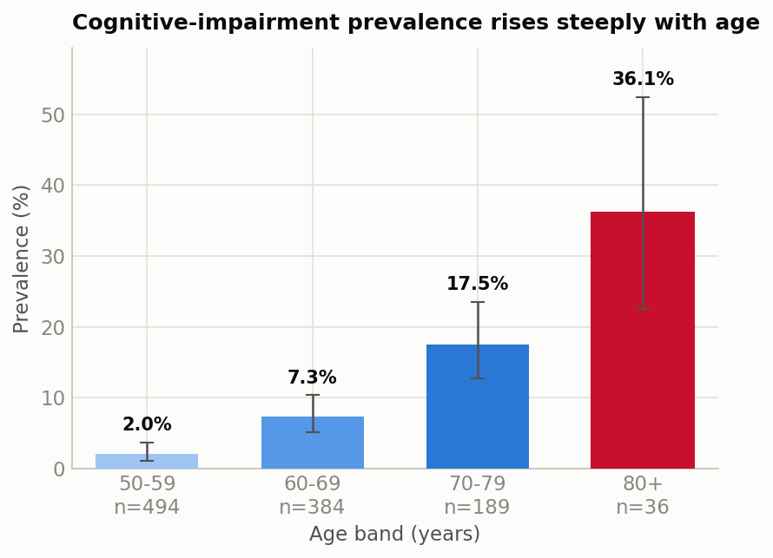
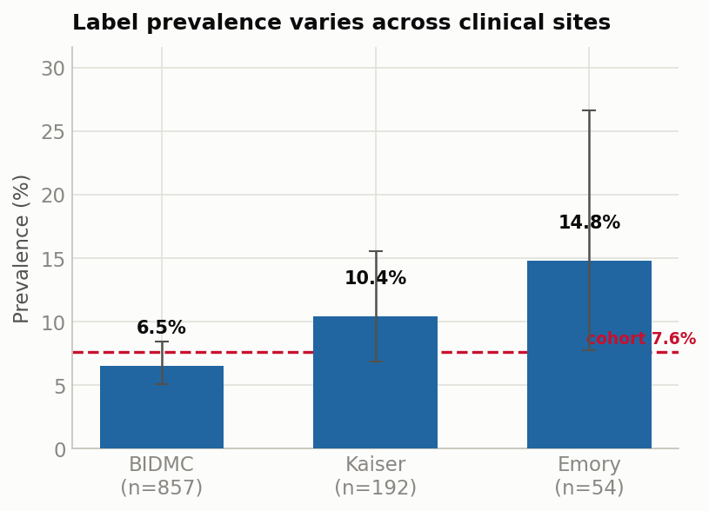
Both problems the metric fixes are visible in our data
DATASET · WHY THE METRIC IS BUILT THIS WAY
Prevalence climbs 2% → 36% across age bands (→ age-conditioned AUROC) and shifts by site 6.5% → 14.8% (→ leave-one-site-out validation).
PhysioNet Challenge 2026 · Scoring Metrics
Notes:
This is the empirical case for the whole scoring design. On the left, prevalence of cognitive impairment by age band: 2% for patients in their fifties, rising to 36% for those 80 and older — an eighteen-fold swing. A lazy model could score well just by learning 'older equals higher risk,' which is precisely why the challenge conditions AUROC on age: it strips that shortcut away. On the right, prevalence by site: from 6.5% at BIDMC to almost 15% at Emory. The error bars are wide at the smaller sites, but the shift is real and it's why we don't trust a single random split. So the two things we said in the abstract — imbalance and age confounding — are not hypothetical; they are right here in the data.

Slide 19
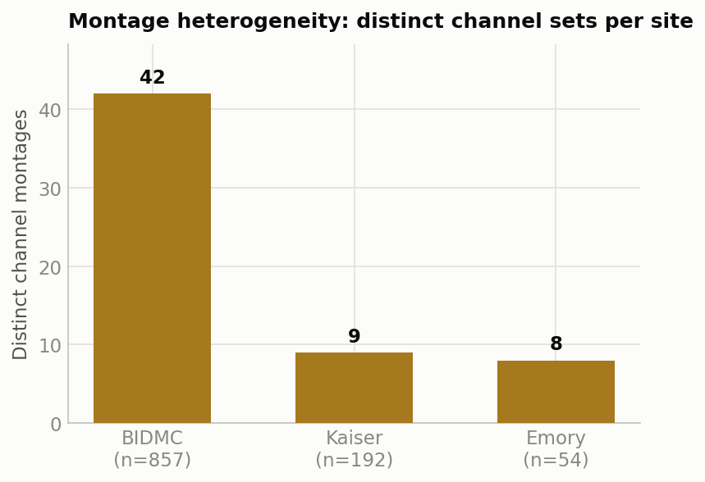
Rich signals, but wildly heterogeneous montages
DATASET · BIOSIGNALS (header scan of 1,103 EDFs)
EKG present in 98.9% of recordings; core EEG (F3/C3/O1…) and SaO₂ in ~81%.
16 – 88 channels per file; sampling rates span 20 – 512 Hz.
BIDMC alone uses 42 distinct channel sets; Kaiser 9, Emory 8.
Same sensor, many labels (SaO2 vs SpO2, CHEST vs Thorax) and mixed units.
Implication: features are computed per channel role and must degrade gracefully when a channel is absent.
PhysioNet Challenge 2026 · Scoring Metrics
Notes:
The biosignals are rich but messy. A header-only scan of all 1,103 EDF files — we never load the 170 gigabytes of samples — shows EKG in almost every recording, and the core EEG derivations plus oxygen saturation in about four out of five. But the montages are wildly inconsistent: files range from 16 to 88 channels, sampling rates from 20 to 512 hertz, and BIDMC alone uses 42 different channel sets. The same sensor shows up under different labels and units. The practical consequence, and a real design constraint for us, is that we extract features by channel role, not by exact label, and every feature has to degrade gracefully when its channel simply isn't there.

Slide 20
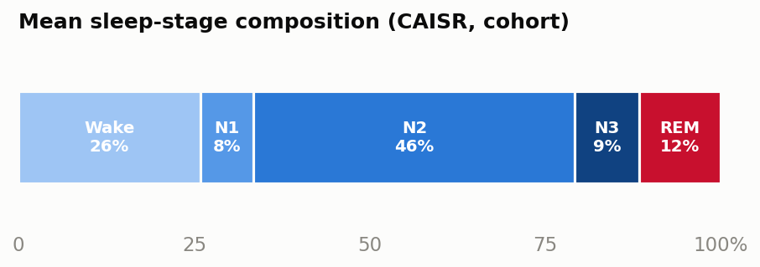
Fragmented sleep and heavy disordered breathing
DATASET · SLEEP ARCHITECTURE (CAISR annotations)
73.6%
sleep efficiency (median 76.8%)
47.9
AHI events / h of sleep
39.7
arousal index / h
332
total sleep time (min)
PhysioNet Challenge 2026 · Scoring Metrics
Notes:
These come from the CAISR automated sleep annotations, which we read for all 1,090 recordings that have them. The stage bar at the top is the cohort-average hypnogram: about a quarter of the night is wake, nearly half is N2, and only 9% is deep N3 and 12% REM. That is a fragmented, shallow sleep profile — consistent with a clinical sleep-lab population. The tiles below make it concrete: median sleep efficiency in the mid-70s, and a strikingly high apnea-hypopnea index of 48 events per hour of sleep, with an arousal index near 40. This is a heavily sleep-disordered cohort, which matters because sleep-disordered breathing is itself linked to cognitive risk. One caveat: CAISR agrees with the expert scorer on about 76% of epochs, so we treat these as strong but imperfect labels.

Slide 21
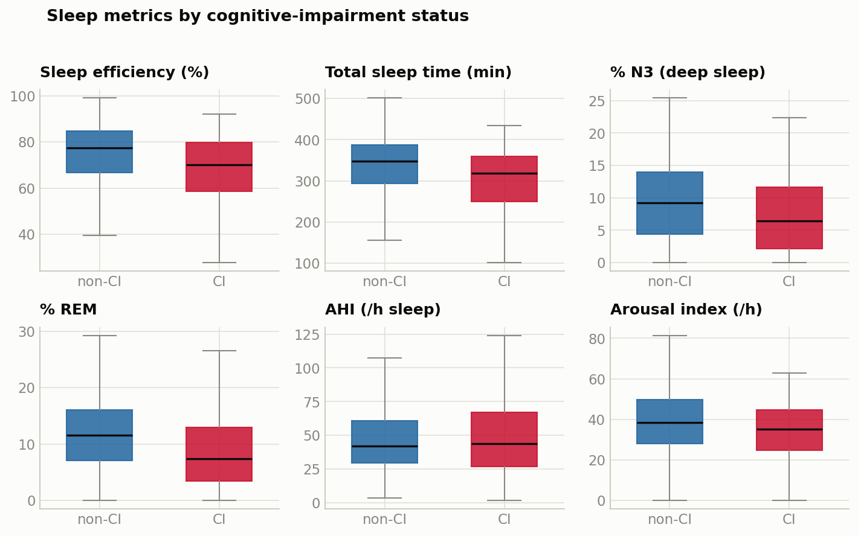
Impaired patients sleep measurably worse
DATASET · THE LEARNABLE SIGNAL (CI vs non-CI)
PhysioNet Challenge 2026 · Scoring Metrics
Notes:
This is the slide that says a model can actually work. Each panel compares the impaired group in red against the unimpaired group in blue. Impaired patients show lower sleep efficiency, shorter total sleep, and notably less deep N3 and REM sleep. The distributions overlap — this is not a clean separation, no single feature is a biomarker — but the shifts are consistent and in the direction sleep medicine would predict. Apnea burden and arousal index are more similar between the groups, which tells us the discriminative signal lives mainly in sleep architecture and continuity, not in the breathing indices. That is exactly why we lean on engineered architecture features rather than raw event counts.

Slide 22
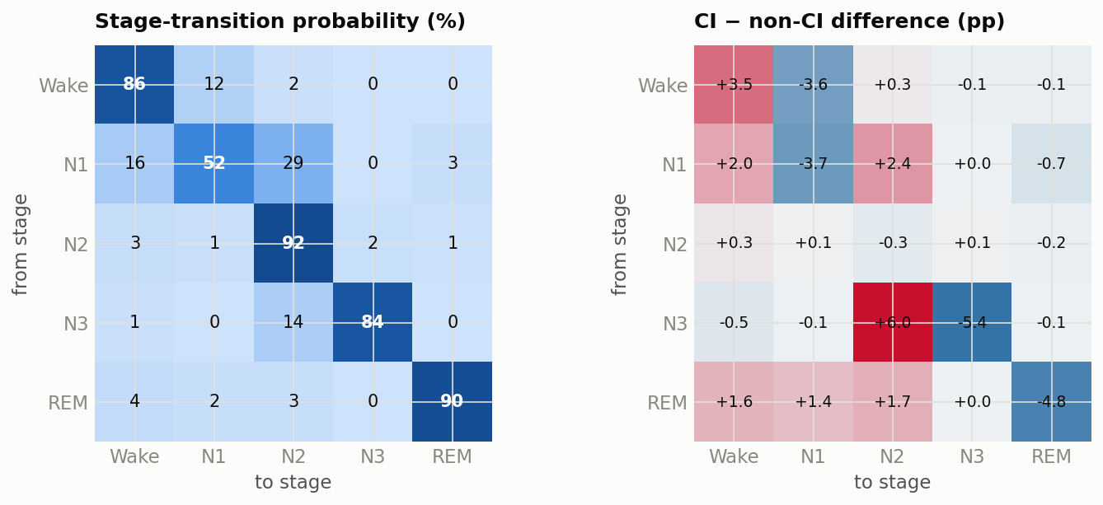
How impaired sleep breaks down, stage by stage
DATASET · STAGE-TRANSITION DYNAMICS
Each cell = P(row stage → next epoch's stage). Impaired patients show a destabilized deep sleep — N3→N3 drops 5.4 pts while N3→N2 rises 6.0 — and less stable REM (−4.8). The mechanism behind their fragmentation.
PhysioNet Challenge 2026 · Scoring Metrics
Notes:
We can go deeper than 'how much' of each stage — into how the night moves between stages. This is the epoch-to-epoch transition matrix: each cell is the probability that a stage is followed by another. The left panel is the whole cohort — sleep is mostly stable, the diagonal is high. The right panel is what's different about the impaired patients, in percentage points. The striking cell is deep sleep: their N3 is far less stable — it drops back to N2 six points more often and holds only 5 points less — and their REM is less stable too. So the fragmentation we saw in the summary metrics has a concrete mechanism: impaired patients can't hold onto their deep, restorative sleep.

Slide 23
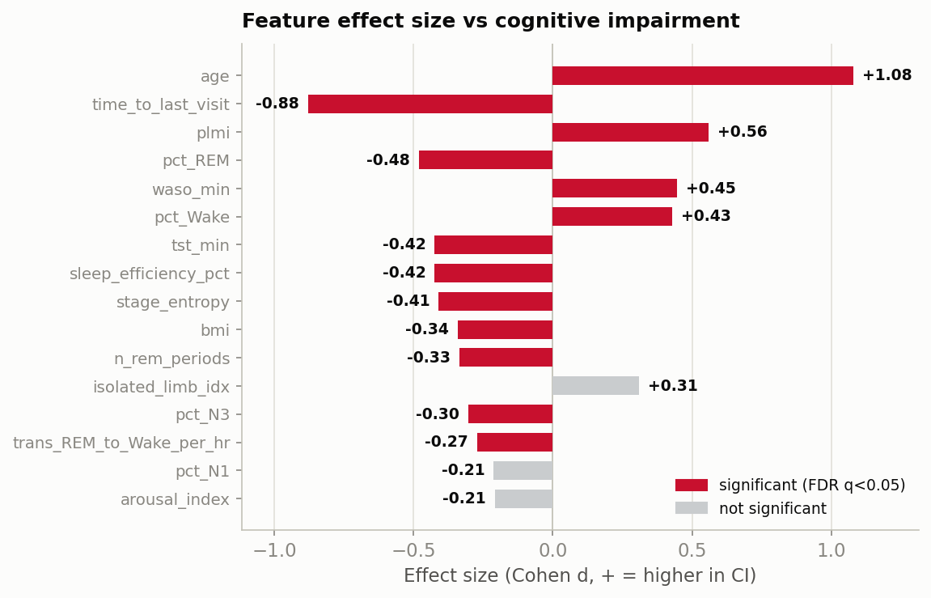
Which features actually separate the groups?
DATASET · FEATURE SIGNIFICANCE (χ² / t-test, FDR-corrected)
14 of 48 features are significant at FDR q<0.05.
Age dominates (Cohen d = 1.08) — exactly why the metric discounts it.
Then: limb movements, ↓REM, ↑WASO/Wake, ↓efficiency & entropy, fewer REM periods, ↓N3.
AHI is NOT significant (d=0.19) — signal is in sleep architecture & continuity, not apnea load.
Method: Welch t (numeric) + χ² (categorical), Benjamini–Hochberg FDR.
PhysioNet Challenge 2026 · Scoring Metrics
Notes:
Finally, a formal answer to 'which features actually matter.' We tested every feature against the impairment label — a t-test for numeric features, chi-square for categorical — and corrected for testing 48 of them at once with a false-discovery-rate adjustment. Fourteen survive at q below 0.05. Age has by far the largest effect, a full standard deviation of separation — which is precisely the shortcut the age-conditioned metric strips away, so we can't lean on it. After age come the sleep features: periodic limb movements, reduced REM, more time awake, lower efficiency and stage entropy, fewer REM cycles, less deep sleep. The important negative result is that the apnea-hypopnea index is NOT significant — so the real signal lives in sleep architecture and continuity, not in how many breathing events a patient has. That directly justifies our feature design.

Slide 24
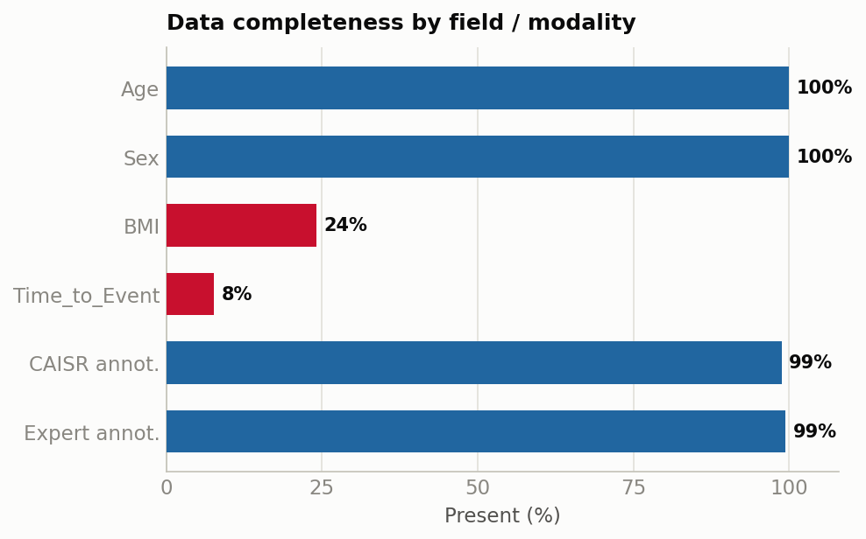
What's present, and what we have to handle
DATASET · COMPLETENESS & QUALITY
Age & Sex complete; race and ethnicity essentially complete.
BMI missing in 76%, Time_to_Event in 92% (recorded for positives only).
1,090 / 1,103 have CAISR — 13 recordings fall back to global features only.
18 short recordings (<4 h; 9 under 1 h) are flagged for the training pipeline.
Demographics ↔ EDF linkage is exact: 0 orphans in either direction.
PhysioNet Challenge 2026 · Scoring Metrics
Notes:
Finally, data quality, because it drives real modeling decisions. The demographics we can count on — age and sex are complete, race and ethnicity nearly so. But BMI is missing for three-quarters of patients and time-to-event for over 90%, recorded only for the positives, so neither can be a load-bearing feature. On the signal side, 1,090 of 1,103 recordings carry CAISR annotations; the 13 that don't fall back to global features. Eighteen recordings are too short — nine under an hour — and we flag those for the pipeline. The one thing that is perfectly clean is the linkage between the demographics table and the EDF files: zero orphans in either direction, so every patient's metadata lines up with their recording.

Slide 25
What this means for our approach
TAKEAWAYS
Optimize the Reward, not accuracy
Tune the decision threshold to maximize prevalence-weighted payoff — accuracy will look worse and that's fine.
1
Protect recall on the rare class
Each caught positive is worth 1/p − 1; a missed one costs −1. Missing impairment is expensive.
2
Don't lean on age
The age-aware AUROCs strip the age shortcut. Features must carry real signal within an age band.
3
Validate with the official code
Score cross-validation folds with evaluate_model.py so our internal numbers match the leaderboard.
4
PhysioNet Challenge 2026 · Scoring Metrics
Notes:
So what does this mean for how we work? Four things. One: we optimize the Reward, not accuracy — we tune our decision threshold to maximize that prevalence-weighted payoff, and we accept that accuracy will look worse. That's fine, even expected. Two: we protect recall on the rare class — every caught positive is worth one-over-p minus one, and every miss costs minus one, so missing impairment is genuinely expensive. Three: we don't lean on age — the age-aware AUROCs will expose it if we do, so our features have to carry real signal within an age band. And four: we validate with the official evaluation code on our cross-validation folds, so our internal numbers actually match what the leaderboard will say.

Slide 26
Our approach & results
Notes:
We've seen the metric and the data it scores. Now here is what Team SDG actually built to win on that metric — the full pipeline from a raw overnight recording to a calibrated impairment probability, the features we engineered, the model, and where our numbers stand today, including one experiment that hasn't paid off yet.

Slide 27
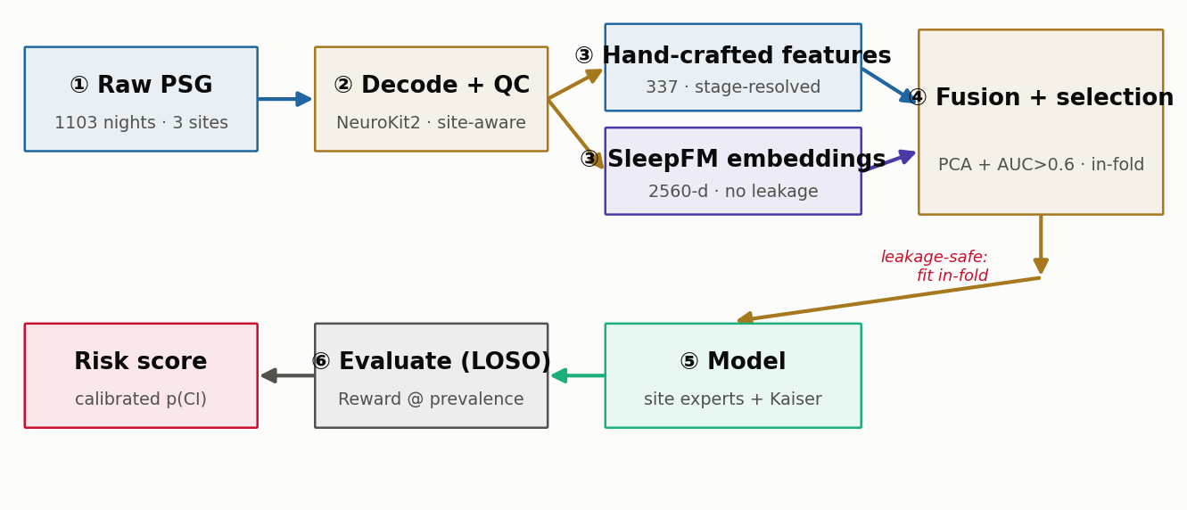
From raw PSG to a calibrated risk score
APPROACH · END-TO-END PIPELINE
Two feature streams fuse leakage-safe (PCA & selection fit in-fold), feed a per-site mixture-of-experts with a Kaiser fine-tune, and a Reward-optimal threshold; validated leave-one-site-out.
PhysioNet Challenge 2026 · Scoring Metrics
Notes:
This is the whole system on one slide. We start from the raw overnight recording — EEG, ECG, respiration, oxygen — decode every channel with NeuroKit2 in a site-aware way, and run quality checks. Then two parallel feature streams: our hand-crafted sleep physiology, and self-supervised embeddings from a foundation model. Everything downstream of the split — the dimensionality reduction and feature selection — is fit only on training rows; with just 84 positives, fitting those on the whole set would inflate our scores by five to ten points, so we are strict about it. The model is a per-site mixture of experts with a fine-tuned head for Kaiser. Finally we tune the decision threshold to maximize the Reward, by site and age decade, and we validate leave-one-site-out so our numbers reflect a genuinely unseen hospital.

Slide 28
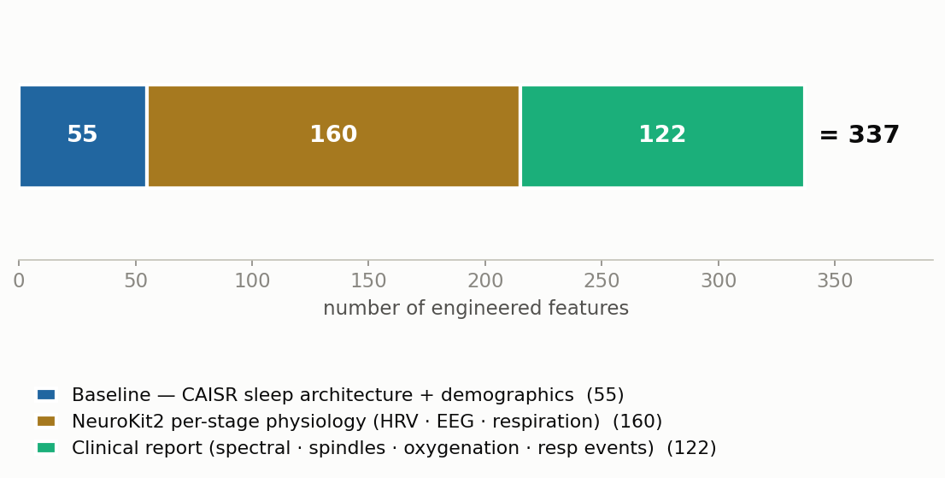
337 engineered features across three families
APPROACH · FEATURE ENGINEERING
Stage-resolved by design — cognitive impairment shows as blunted modulation across sleep stages, so features are computed per stage and the flagship ones are cross-stage contrasts. Age is excluded from training.
PhysioNet Challenge 2026 · Scoring Metrics
Notes:
Our features come in three families. The baseline set — 55 features — is the CAISR sleep architecture and demographics: how the night is structured, fragmentation, event indices. On top of that we added 160 NeuroKit2 features: per-stage heart-rate variability, EEG complexity, and respiration, computed from the raw waveforms. And 122 clinical-report features: EEG spectral power and spindles, oxygenation and hypoxic burden, respiratory events. The design principle is that impairment shows up as blunted modulation across sleep stages, so almost everything is stage-resolved, and the strongest features are contrasts between stages. Crucially, we exclude age from training — the metric strips the age shortcut, so our features have to carry signal within an age band.

Slide 29
A model built for site shift and class imbalance
APPROACH · THE MODEL
Site mixture-of-experts
A HistGradientBoosting classifier per site (BIDMC · Kaiser · Emory) with a global fallback — so each hospital's montage & population is modeled on its own terms.
Kaiser fine-tune
A dedicated fine-tuned head for the Kaiser site, the hardest to generalize to, layered on top of the shared model.
BMI imputation
BMI is missing for 76% of patients, so it is imputed per site rather than dropped — no feature is allowed to silently vanish.
Reward-optimal threshold
Predict positive when the probability clears the age-specific prevalence — the Bayes-optimal rule for the prevalence-weighted Reward, tuned by site & decade on validation.
PhysioNet Challenge 2026 · Scoring Metrics
Notes:
The model is designed around the two problems we keep coming back to: site shift and class imbalance. First, it is a mixture of experts — one gradient-boosted classifier per site, with a global fallback — because the three hospitals have such different montages and populations that a single model blurs them. Second, a dedicated fine-tuned head for Kaiser, which is the hardest site to generalize to. Third, because BMI is missing for three-quarters of patients, we impute it per site instead of dropping it. And the piece that directly targets the metric: instead of the usual 0.5 cutoff, we predict positive when the probability exceeds the age-specific prevalence — that's the Bayes-optimal threshold for the Reward — tuned per site and age decade on held-out validation.

Slide 30
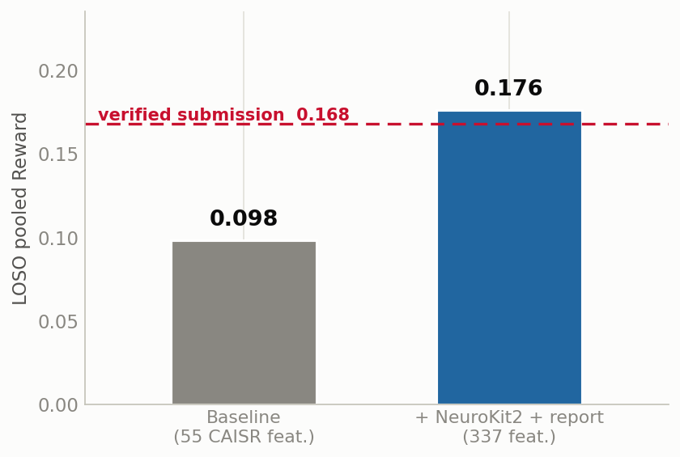
Engineered features nearly doubled the internal reward
RESULTS · INTERNAL LOSO BENCHMARK
+ NeuroKit2 & report features lift pooled LOSO reward 0.098 → 0.176 on the same harness — improving every held-out site.
Reward 0.168 is the verified submission (official evaluate_model.py).
The raw 337-feature union overfits — feature selection is the next lever (below).
Caveat: this internal harness scores the baseline at 0.098, not 0.168 — the relative lift is trustworthy; the absolute number needs reconciling before quoting vs the leaderboard.
PhysioNet Challenge 2026 · Scoring Metrics
Notes:
Here is where the engineered features get us. On our internal leave-one-site-out harness — same folds, same model, only the feature set changes — adding the NeuroKit2 and clinical-report features lifts the pooled reward from 0.098 to 0.176, nearly double, and it improves every single held-out site. For reference, 0.168 is our verified submission score from the official scoring code. One honest caveat: this internal harness scores the baseline at 0.098, not at the 0.168 we submitted, so the two aren't the identical pipeline — the relative lift is what we trust, and the absolute number still needs reconciling before we quote it against the leaderboard. The other lesson: throwing all 337 features in raw actually overfits, which points straight at feature selection as the next lever — and that's the last slide.

Slide 31
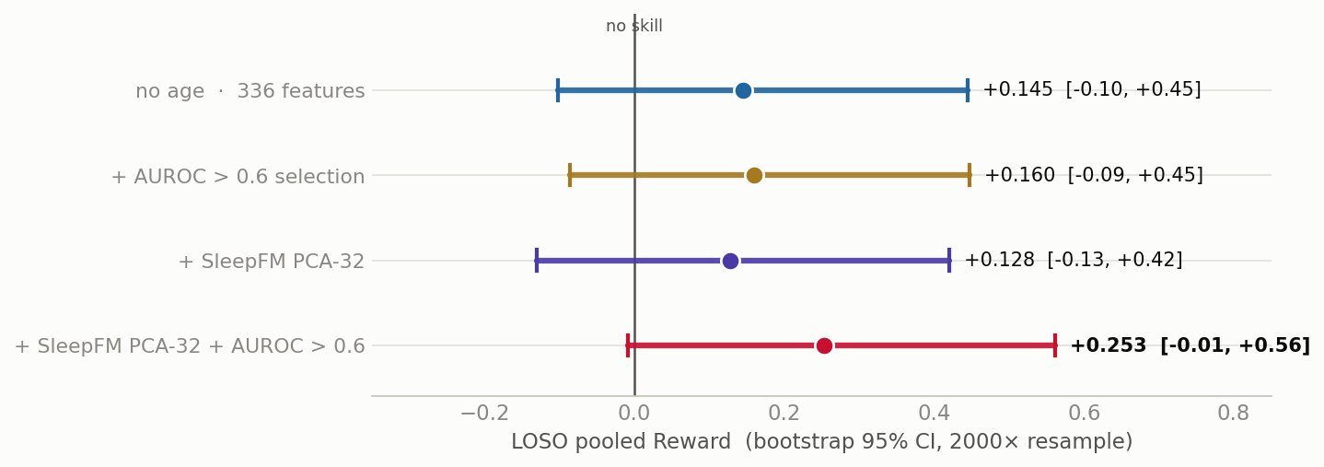
Can a foundation model add more? Not yet.
RESULTS · SLEEPFM EMBEDDING FUSION (in progress)
SleepFM embeddings (self-supervised, no CI labels) fused leakage-safe with our features.
Best point estimate 0.253 LOSO — but its 95% CI still includes 0.
Paired test is the verdict: adding embeddings on top of feature selection gives Δ = −0.10 [−1.32, +0.66] — not distinguishable from selection alone.
Next: per-stage PCA, late-fusion/stacking, and more labeled data to shrink the CIs (84 positives is the binding constraint).
PhysioNet Challenge 2026 · Scoring Metrics
Notes:
I want to end with an experiment that is still open, because it shows how we work. A collaborator produced embeddings from SleepFM, a self-supervised foundation model that was never trained on impairment labels, so there's no leakage. We fused them with our features the leakage-safe way and benchmarked. The best configuration reaches a reward of 0.253 leave-one-site-out — which looks like a big jump. But look at the confidence intervals: every one of them still includes zero. And the decisive test is the paired comparison — on identical splits, adding the embeddings on top of plain feature selection changes the reward by minus 0.10, with a confidence interval from minus 1.3 to plus 0.66. In other words, we cannot yet distinguish the embeddings' contribution from the feature selection alone. So we are not claiming this as a win. The binding constraint is that 84 positives makes every interval wide; the next steps are richer per-stage pooling, stacking, and more labeled data.

Slide 32
References
SOURCES
Challenge website — George B. Moody PhysioNet Challenge 2026
physionetchallenges.org/2026/
Evaluation code — Official scoring implementation
github.com/physionetchallenges/evaluation-2026
Example code — Python entry template
github.com/physionetchallenges/python-example-2026
This deck — Metric definitions taken directly from evaluate_model.py in our repository
PhysioNet Challenge 2026 · Scoring Metrics
Notes:
Everything I've presented is grounded in primary sources. The challenge website and the official evaluation and example code repositories are listed here. And importantly, the metric definitions in this deck — the exact formulas — were taken directly from the evaluate_model.py file in our own repository, and I verified the reward-normalization claim by simulation. So these aren't approximations; they're the real scoring rules.

Slide 33
Questions?
Key takeaway
Optimize for the Reward — catch the rare cases, and don't lean on age.
Arshia Ilaty · SDG · PhysioNet Challenge 2026
Notes:
To wrap up: if you remember one thing, make it this — optimize for the Reward, catch the rare cases, and don't lean on age. That's what wins this challenge. Happy to take questions.

